Slide 1

Samsung PRISM: Monthly Connect - 1
Date: 29th January 2024
Worklet 1: Build an LLM Backed Prompt Generator [NLP Queries > Efficient Prompts]
Team
College Professor(s):
Dr. Lydia Jane G | lydiajane.g@vit.ac.in
Dr. Tamizharasi T | tamizharasi.t@vit.ac.in
Students:
Agrim Patil | agrim.patil2021@vitstudent.ac.in
Shreya Gupta | shreya.gupta2021a@vitstudent.ac.in
Debosmita Chatterjee | debosmita.chatterjee2021@vitstudent.ac.in
Department: SCOPE: School of Computer Science and Engineering

Slide 2
Context
Develop an AI-driven Prompt Generator leveraging LLM (Large Language Model) technology, catering to natural language queries for precise image generation. The system should interpret diverse user inputs, utilizing LLM's understanding to craft concise, contextually accurate prompts. The objective is to facilitate image creation based on user-specified criteria, ensuring the generated prompts effectively guide image generation models for accurate and desired visual outputs.
Build an LLM Backed Prompt Generator [NLP Queries > Efficient Prompts]

Slide 3
Drawbacks of an Inefficient Prompt?
If a prompt lacks specificity or fails to provide essential details, the generated response may lack depth or accuracy. This is particularly important when seeking detailed or precise information.
Language models heavily rely on context to provide meaningful responses. Inefficient prompts that do not convey the context properly may lead to responses that are irrelevant or fail to address the intended inquiry.
Inefficient prompts may not fully leverage the capabilities of the language model. Well-constructed prompts that showcase the model's capabilities can lead to more insightful and varied responses
Inefficient prompts may be vague or unclear, leading to misinterpretation by the language model. This can result in inaccurate or irrelevant responses, hindering effective communication.
Inefficiency in prompts can waste computational resources and time. Unfocused or poorly crafted prompts may result in the model generating unnecessary or excessive information, consuming more resources than needed.

Slide 4
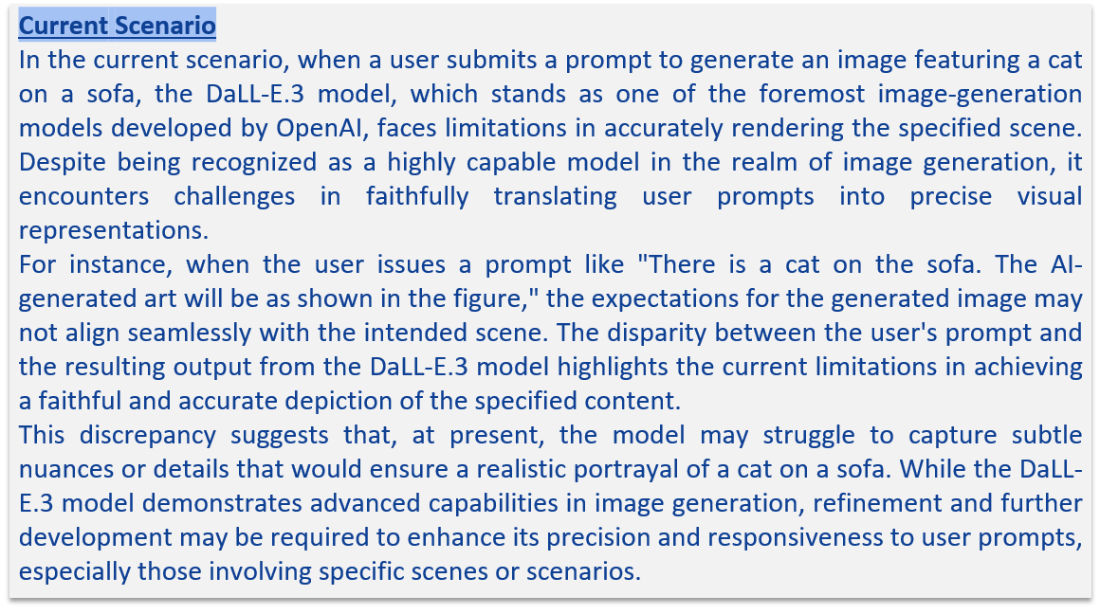
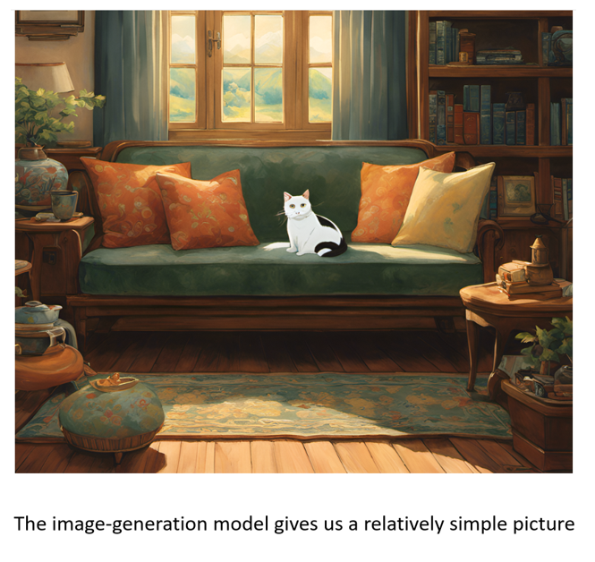

Slide 5

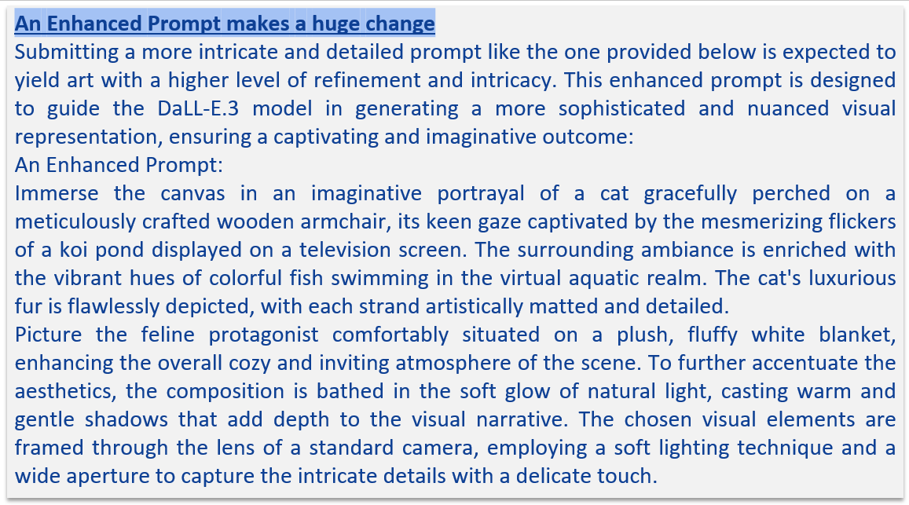

Slide 6


Slide 7
Bases of an efficient prompt .Enhancing Text Generation.
There are four strategies for getting better results.
1. Write clear instructions
These models can’t read your mind. If outputs are too long, ask for brief replies. If outputs are too simple, ask for expert-level writing. If you dislike the format, demonstrate the format you’d like to see. The less the model has to guess at what you want, the more likely you’ll get it. Tactics: Include details in your query to get more relevant answers, Ask the model to adopt a persona, Use delimiters to clearly indicate distinct parts of the input, Specify the steps required to complete a task, Provide examples,Specify the desired length of the output
2. Split complex tasks into simpler subtasks
Just as it is good practice in software engineering to decompose a complex system into a set of modular components, the same is true of tasks submitted to a language model. Complex tasks tend to have higher error rates than simpler tasks. Tactics: Use intent classification to identify the most relevant instructions for a user query, For dialogue applications that require very long conversations, summarize or filter previous dialogue, Summarize long documents piecewise and construct a full summary recursively.

Slide 8
Bases of an efficient prompt.
3. Provide reference text
Language models can confidently invent fake answers, especially when asked about esoteric topics or for citations and URLs. In the same way that a sheet of notes can help a student do better on a test, providing reference text to these models can help in answering with fewer fabrications.
Tactics:
Instruct the model to answer using a reference text
Instruct the model to answer with citations from a reference text
4. Give the model time to "think“
Tactics:
Instruct the model to work out its own solution before rushing to a conclusion
Use inner monologue or a sequence of queries to hide the model's reasoning process
Ask the model if it missed anything on previous passes
Reference:https://platform.openai.com/docs/guides/prompt-engineering/six-strategies-for-getting-better-results

Slide 9
Using OpenAI API to access GPT 3.5.
Considering all the LLM’s available we decided to use OpenAI’s GPT3.5 Model for the working prototype:
GPT-3.5 is one of the largest language models, with 175 billion parameters. Its vast size allows it to capture a wide range of complex patterns and relationships in data, making it highly capable in various natural language processing (NLP) tasks.
GPT-3.5 is designed to perform few-shot learning, meaning it can generate meaningful responses with minimal examples or context provided in the input. This makes it user-friendly and easy to adapt for various applications.
OpenAI provides an API for GPT-3.5, allowing developers to integrate its capabilities into their applications, products, or services. This accessibility facilitates the use of GPT-3 in a wide range of real-world scenarios.
The model is adept at understanding context and maintaining coherence over longer passages of text. This is crucial for generating human-like responses and understanding the context of a conversation or prompt.

Slide 10
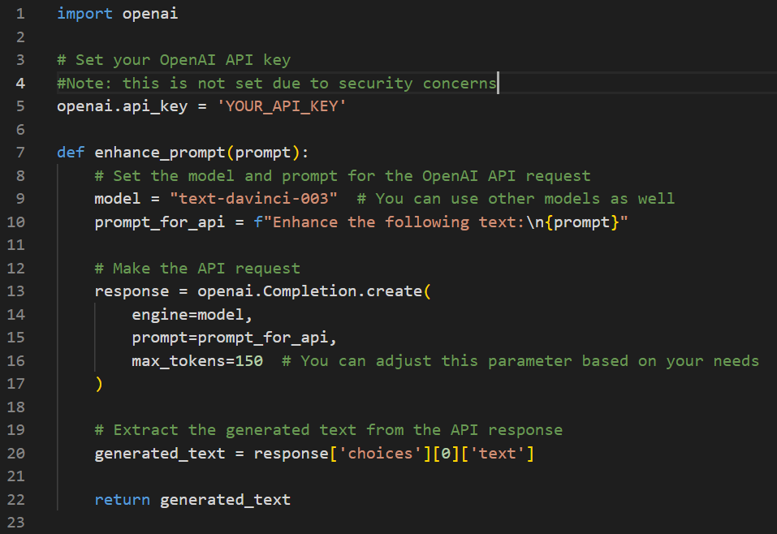
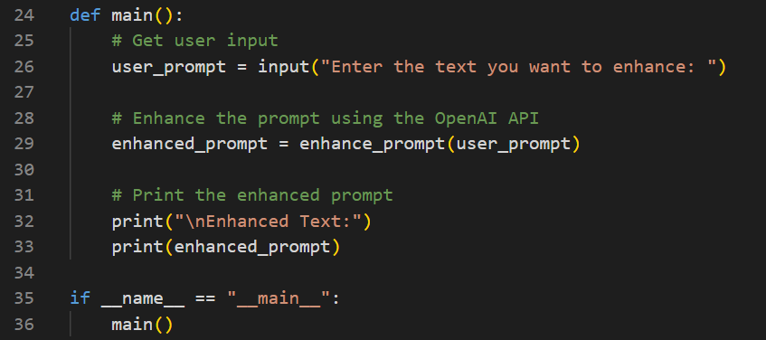
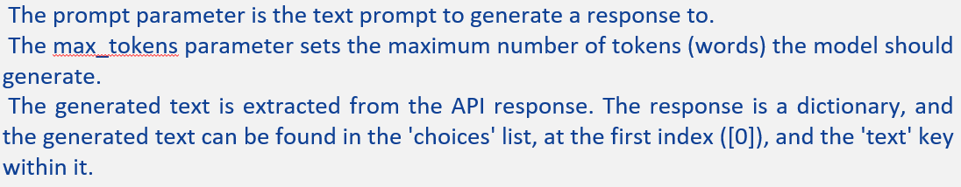

Slide 11
Different parameters are used in the above code; here is an explanation of them:
This program will prompt the user for input, send that input to the OpenAI API, and prints an enhanced prompt from the response from GPT3.5.
The engine parameter means which language model to use ("text-davinci-003" is the most powerful GPT-3.5 model.
The prompt parameter is the text prompt to generate a response to.
The max_tokens parameter sets the maximum number of tokens (words) the model should generate.
The generated text is extracted from the API response. The response is a dictionary, and the generated text can be found in the 'choices' list, at the first index ([0]), and the 'text' key within it.
Github Link to the repo: https://github.com/Agrim-P777/Prompt-Enhancer/tree/main

Slide 12
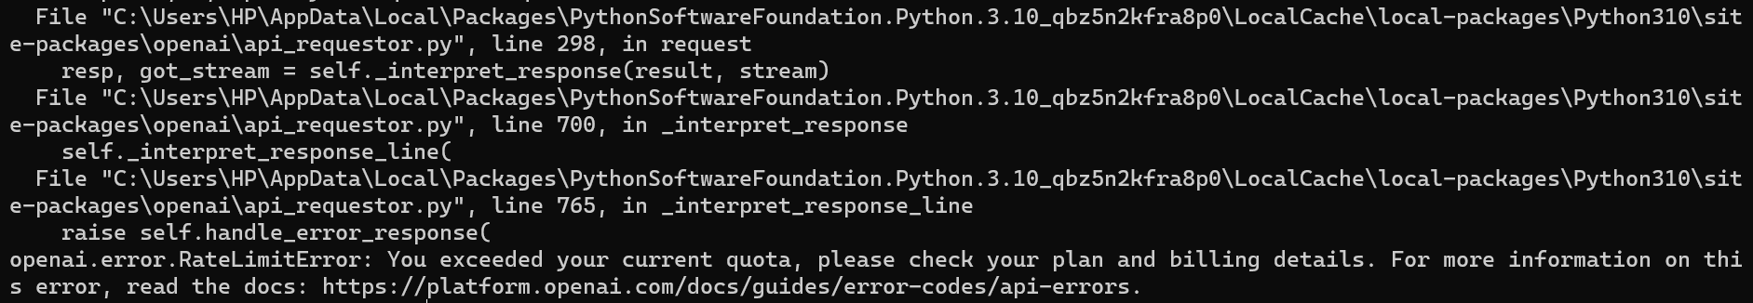
Warning! Depreciated use of OpenAPI v0.28
1. In the recent update, OpenAI has changed the usage on the API’s particularly changing the “text-davinci-003“ model to “gpt-3.5-turbo-instruct” which has a limit on its usage and the developer has to pay credits to use the model’s API.
2. Working with the GPT-3.5 API can incur costs, so we limited the usage until we confirmed the pricing details on the OpenAI platform.

Slide 13
Work-let Name: Build an LLM Backed Prompt Generator [NLP Queries > Efficient Prompts]
Worklet Details
Worklet ID: 23RSG23
Agrim Patil - 21BCE3970
College Name: Vellore Institute of Technology
Surveyed the current SOTA(State-of-the-Art) LLM’s and Prompt generators.
Reviewing the various available Open-source LLM’s
Any Challenges/ Issues faced
Change of OpenAI API Policies.
To develop strategies to decide on what an efficient prompt
is.
3. Considering which LLM to use based on our use cases, cost,
copyright and efficiency
KPIs achieved till now
Next Steps:
To confirm OpenAI’s API policies and pricing for the continuation of GPT3.5 as the LLM.
If the GPT3.5 is not satisfying our requirements, Llama2 from Meta AI will be preferred.
Llama2 being open-sourced, we can download the model and train it for our specific use.
Key Achievements/ Outcome till now
Set parameters to gauge how efficient a prompt is
2. Learned about (Chain-of-Thought Prompting)
3. Use of OpenAI API’s. to access GPT3.5 (v 0.28)
Date: 29th January

Slide 14
Work-let Name:Build an LLM backed prompt Generator[NLP Queries > Efficient Prompts]
Worklet Details
Worklet ID: 23RSG23
College Name: VIT VELLORE
Name: DEBOSMITA CHATTERJEE
Reg No: 21BCB0062
1.Fine-tuning Complexity-optimizing numerous hyperparameters, training settings, and tuning strategies requires computational resources and expertise in model training and optimization techniques
2.Efficiency and Scalability-How can our model be made more efficient and scalable in order to minimize scope for errors.
KPIs achieved till now
1.Dwelled into the realms of various language models such as ELMo,BERT,GPT,RoBERTa,ALBERT referring to published research papers and projects.
2.Researched on fine tuning the pre trained language models.
3.Zero-shot Prompting and Few-shot learning:
Zero-shot prompting-querying LLMs with a prompt that hasn’t been seen in the training data of the model. Such prompts typically provide specific task instructions along with the main query. Given the sensitivity of LLMs to the structure and content of prompts, careful prompt engineering is crucial to achieve optimal performance
Few-shot learning-referred to as incontext learning, few-shot learning is a technique where LLMs are provided with a handful of examples to guide their responses.
Any Challenges/ Issues faced
Next Steps
Diving deep into how to Fine Tune and Evaluate the model
1.Got an understanding of various language models and how they can be implemented efficiently to fit into our required model
2.Studied about Chain of thought and skeleton of thought
Key Achievements/ Outcome till now
Date: 29th January

Slide 15
Language Models
ELMo (Embeddings from Language Models) and BERT (Bidirectional Encoder Representations from Transformers) are two prominent language models that have significantly advanced natural language processing tasks.
1. ELMo (Embeddings from Language Models)::
- Overview: ELMo, introduced by researchers at Allen Institute for Artificial Intelligence (AI2) in 2018, is a contextual word representation model. Unlike traditional word embeddings like Word2Vec or GloVe, ELMo produces word representations that are sensitive to the context in which the words appear.
- Example: Let's say we have the sentence "The bank is closed today." In this sentence, the word "bank" could refer to a financial institution or the side of a river. ELMo captures this contextual information by assigning different vector representations to "bank" based on its context in the sentence.
2. BERT (Bidirectional Encoder Representations from Transformers)**:
- Overview: BERT, developed by researchers at Google in 2018, is a transformer-based language model. It is trained on a large corpus of text using a masked language modeling objective, allowing it to generate contextualized word representations bidirectionally.
- Example: Suppose we have the sentence "He plays the guitar." BERT, being bidirectional, considers both the left and right contexts of each word when generating embeddings. So, the representation of "plays" would take into account both "He" and "the guitar" when producing its embedding.
Both ELMo and BERT have been influential in various NLP tasks such as sentiment analysis, named entity recognition, question answering, and more. They have also paved the way for subsequent models that further improve upon their architectures, such as GPT (Generative Pre-trained Transformer) series, RoBERTa, and ALBERT.
3.GPT (Generative Pre-trained Transformer):
Overview: Developed by OpenAI, the GPT series consists of large-scale transformer-based language models trained using unsupervised learning on vast amounts of text data. GPT models are capable of generating coherent and contextually relevant text, making them suitable for various natural language understanding and generation tasks.
Example: GPT-3, the latest iteration in the series, is known for its impressive performance on a wide range of tasks, including language translation, text completion, and question answering.
4.RoBERTa (Robustly optimized BERT approach):
Overview: RoBERTa is a variant of BERT developed by Facebook AI. It builds upon the BERT architecture but incorporates several modifications and optimizations to improve its performance. RoBERTa is particularly known for its robustness and effectiveness across various NLP tasks.
Example: RoBERTa achieves state-of-the-art results on benchmarks such as GLUE (General Language Understanding Evaluation) and SQuAD (Stanford Question Answering Dataset).
5.ALBERT (A Lite BERT):
Overview: ALBERT is a lite version of BERT introduced by Google AI researchers. It addresses some of the inefficiencies present in the original BERT model by applying parameter reduction techniques such as factorized embedding parameterization and cross-layer parameter sharing.
Example: ALBERT achieves comparable performance to BERT while requiring fewer parameters, making it more memory-efficient and scalable.

Slide 16
hello
6. T5 (Text-To-Text Transfer Transformer):
Overview: T5 is a transformer-based model developed by Google AI. Unlike previous models that are task-specific, T5 is designed to perform various NLP tasks using a unified text-to-text framework. It achieves this by casting all NLP tasks into a text-to-text format, where inputs and outputs are represented as text strings.
Example: T5 can be fine-tuned for tasks such as text summarization, machine translation, and text classification by formulating each task as a text-to-text problem.
7. XLNet:
Overview: XLNet, developed by researchers at Google and Carnegie Mellon University, is a transformer-based language model that introduces a novel permutation-based training objective called "permutation language modeling." This approach allows XLNet to capture bidirectional context information while maintaining the advantages of autoregressive models.
Example: XLNet achieves state-of-the-art results on various benchmark datasets and tasks, showcasing its effectiveness in capturing complex dependencies in natural language.

Slide 17
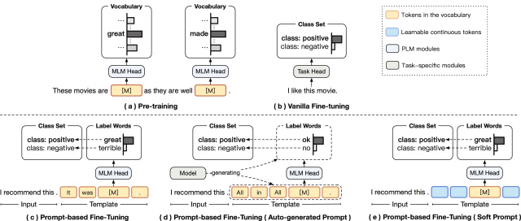
"Language Models as Knowledge Bases?" by Petroni et al. (2020)
The LAMA Probe: Introduced the LAMA (LAnguage Model Analysis) probe to test the factual and commonsense knowledge in language models. It provides a set of knowledge sources which are composed of a corpus of facts. Facts are either subject-relation object triples or question-answer pairs. Each fact is converted into a cloze statement which is used to query the language model for a missing token. Work is to evaluate each model based on how highly it ranks the ground truth token against every other word in a fixed candidate vocabulary. This is similar to ranking-based metrics from the knowledge base completion literature (Bordes et al., 2013; Nickel et al., 2016). The assumption is that models which rank ground truth tokens high for these cloze statements have more factual knowledge.

Slide 18
PTR: Prompt Tuning with Rules for Text Classification
Xu Han a, Weilin Zhao , Ning Ding , Zhiyuan Liu , Maosong Sun
Recently, pre-trained language models (PLMs) (Devlin et al., 2019) have emerged as an effective NLP instrument, since PLMs can capture linguistic (Jawahar et al., 2019), semantic (Yenicelik et al., 2020), syntactic (Hewitt and Manning, 2019), and world knowledge (Petroni et al., 2019) from large-scale corpora. By fine-tuning PLMs on task specific data, the rich knowledge of PLMs can well serve various downstream NLP tasks (Qiu et al., 2020). Despite the success of fine tuning PLMs, recent studies (Liu et al., 2021a) indicate one critical challenge — the gap of objective forms between pre-training and finetuning. As shown in Fig. 1(a), PLMs are usually pre-trained with a cloze-style task. However, in the fine-tuning phase like Fig. 1(b), we are required to tune all PLMs’ parameters and task-specific heads (e.g., linear layers for classification) with task-specific objectives. From a transfer learning perspective (Pan and Yang, 2009), this objective gap may hinder the adaptation of PLMs’ knowledge to downstream tasks. To bridge the above-mentioned gap of objective forms, prompt tuning has been introduced (Brown et al., 2020). A typical prompt consists of a template and a label word set. As shown in Fig. 1(c), a classification task can be transformed into a cloze-style objective form, by combining the input and the template to predict the masked position [𝙼] and then mapping the predicted words to the corresponding class labels. The label word set serves as the candidate set for predicting [𝙼]. Intuitively, using the template ‘‘< 𝚂1>. It was [𝙼].’’ and the label set {‘‘great’’, ‘‘terrible’’} for sentiment classification, we can determine whether < 𝚂1> is positive or negative based on PLMs predicting ‘‘great’’ or ‘‘terrible’’ at [𝙼]. Besides sentiment classification, prompt tuning has also achieved promising results on some other few-class classification tasks such as natural language inference (Schick and Schütze, 2021; Liu et al., 2021b). However, for those tasks with many classes, it becomes challenging to manually find appropriate templates and suitable label words to distinguish different classes. For example, relation classification, a typical many-class classification task, requires models to predict semantic relations between two marked entities in the text. Given the relation ‘‘person:parent’’ and the relation ‘‘organization:parent’’, it is hard to pick templates and label words to distinguish them.
Compared with existing prompt tuning methods, PTR has two advantages: (1) Prior Knowledge Encoding. Prior task knowledge can effectively help solve specific tasks. For example, in relation classification, considering that the prediction results are related to both sentence semantics and entity types, and we can build prompts based on two sub-prompts, one for detecting entity types and the other for detecting relational semantics between entities. For other tasks like entity typing and intent classification, their class hierarchies are also good priors for designing prompts. By encoding prior task knowledge, we can obtain effective models even without sufficient training data. (2) Efficient and Effective Prompt Design. Compared with manually designing individual templates and label words for each class, it is easier to design a few simple sub-prompts and combine them according to rules to handle specific complex tasks. Compared with auto-generated and soft prompts, using rules to generate prompts is more efficient and effective. Considering intuitiveness, we use humanpicked sub-prompts in this paper to introduce PTR, yet PTR is an open framework and sub-prompts can also be auto-generated and soft ones. To verify the effectiveness of PTR, we conduct experiments on three typical many-class classification tasks, including relation classification, entity typing, and intent classification. The experimental results show that PTR can outperform vanilla fine-tuning and prompt tuning baselines, indicating that PTR is a promising approach to take advantage of both prior task knowledge and PLMs for those complicated classification tasks.

Slide 19
Work-let Name: Build an LLM backed prompt Generator[NLP Queries -> Efficient Prompts]
Worklet Details
Worklet ID: 23RSG23
College Name: Vellore Institute of Technology
Name: Shreya Gupta (21BCB0142)
KPIs achieved till now
1. Researched on various types of prompt databases available (NLP models, creative writing, educational tools, chatbots and conversational agents, research and evaluation)
2. Explored various prompt databases available for image generation task (text-to-image synthesis, conditional GANs, interactive inputs, style transfer, data augmentation, attribute manipulation)
3. Developed a frontend framework to take user input for a prompt and display its enhanced version (working prototype of first module - enhancing the user input prompt)
Any Challenges/ Issues faced
Enhancing the prompt to a greater extent so as to improve the quality of the image generated in the first attempt itself, rather than user modifying via iterations.
1. Enhancing the user input to generate a better prompt
2. Exploration of the various prompt databases available (relevant to the problem statement) which can be used in future
Next Steps
Developing the working prototype further with incorporation of the next module, that is displaying the output of images generated directly as per user's prompt and with the modified prompt.
Key Achievements/ Outcome till now
Date: 29 Jan 2024

Slide 20
Thank you!

